Slide 1
Setting up for modeling
Remember goals:
  Desired model and uncertainty
Sample area selection
What resolution will we model at?
What are we modeling?
How will we validate the model?
Do we have enough sample data or too much?
Do we have the predictor variables we need?

Slide 2
Sample Area Selection
What is the area of interest?
How was the area sampled?
  Optimal: rigorously sampled, randomly spaced plots
  Worse case: data integrated from multiple sources with little documentation on collection methods
How far can we extend the study area realistically?
Best to pad the extent a bit

Slide 3
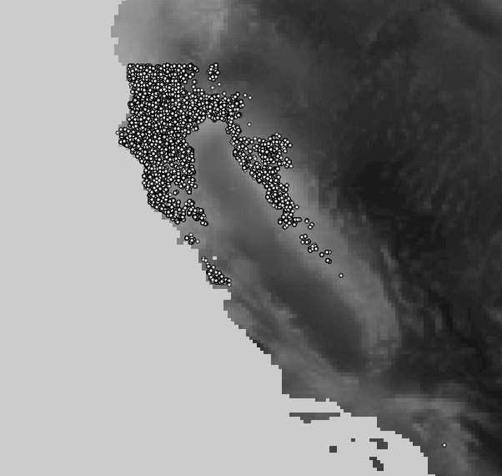
Sample Area Selection
CA – Douglas fir

Slide 4
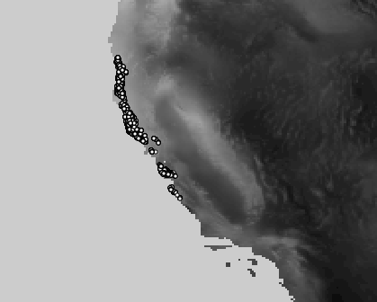
Sample Area Selection
CA – Redwood (coastal)

Slide 5
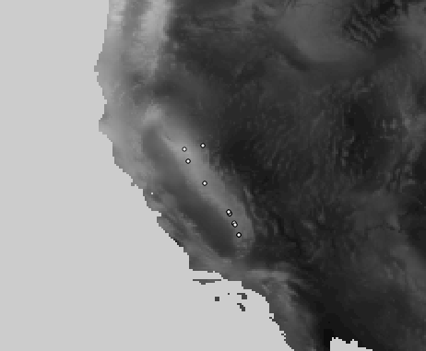
Sample Area Selection
CA - Giant Sequoia

Slide 6
Resolution
Higher resolution:
  Better detail
  Can be misleading
  Performance problems
Lower resolution:
  Much faster processing
  Can hide “niche environments”
Recommendation:
  Use lowest predictor layer resolution for all layers, or lower
  Grid to lower resolution as needed

Slide 7
What are we modeling?
Need a relationship we can model
Measured variables:
  Height, DBH, Canopy size
  Weight, length, grain size, proportion
  Income, longevity
Presence/Absence:
  Logistic regression
Occurrences:
  Point Density?

Slide 8
Sample Data
Too many points will overwhelm R
  Sub-sample
  Aggregate
Too few points will not represent the phenomenon
  Get more data?
  Switch to a simulation
  Give up?

Slide 9
Predictors
Look far and wide
Transform predictors as needed
Investigate what will predict the phenomenon
  Visit the site, talk to “experts”
  Switch to a simulation?
  Give up?

